Slide 1
Introduction to Programming with Python
By: Iman Khani Jazani
Senior Data Scientist, Adin
Technical AI Product Manager and Advisor, Mehra
AI and Data Specialist, AiHum
Adjunct Professor, Sharif University of Technology

Slide 2
Last lecture
Review the Last Lecture
History of Computation and Computers
Component of a Computer System
Type of Programs in Computers
Algorithm: Programs Brain
Application of Programming in the Digital Age!

Slide 3
Today
Short Presentations
Review the Last Lecture
Primitive Instructions
Language Structure
Python Programming Language
Application of Programming in the Digital Age!

Slide 4
Together
Send your feedback about the class whenever you want!

Slide 5
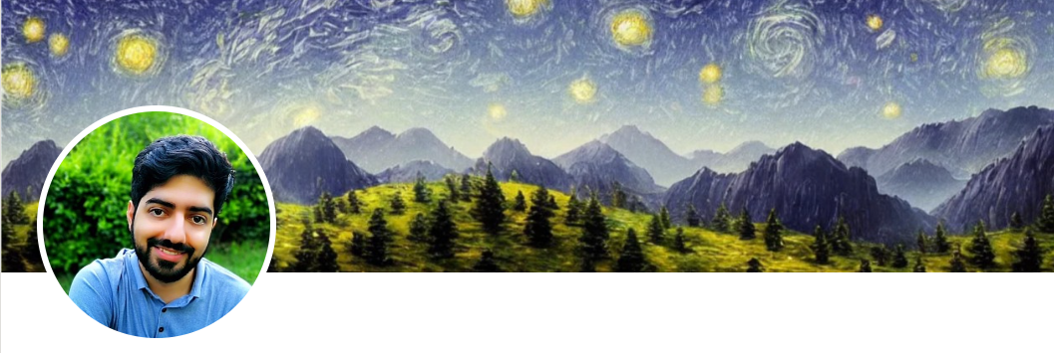
Contact me
Gmail: ImanKhaniJazani@gmail.com
LinkedIn: https://www.linkedin.com/in/ImanKhaniJazani/
Telegram: @IKJ1992

Slide 6

Main links for our class
از 5 اسفند گروه خصوصی میشود!
Telegram group: t.me/SharifPythonSpace1401
GitHub organization: github.com/SharifPythonSpace

Slide 7
Grading
راه جبران هم تحت شرایطی وجود داره!
Approx. 25% Programming Assignments (judgment with Quera)
Approx. 14% Mid-term Project (alone, judgment with TAs and Quera)
Approx. 37% Final Project (team work~5 member, judgment with TAs and Quera)
Proposal (about real needs)
Coding
Release
Approx. 30% Final Exam (algorithm-based paper exam)
Approx. 5% Presentation with Code(extra score , for the next week lecture, only for the first two person)
Approx. 2% Challenging Questions and Contributions in Class (extra score)
Approx. 7% long presentation (extra score)
Notes:
120 score

Slide 8
Time for TA class!
Check our Telegram group!

Slide 9
Short Presentations

Slide 10
What is flowchart? What is better than a flowchart?
Who is volunteer for the short presentation?

Slide 11
How computers can connect to each other from a wide range or through the internet?
Who is volunteer for the short presentation?

Slide 12
Review the Last Lecture

Slide 13
Computing timeline
1600
Mechanical Calculators
1700
Difference Engine
1800
Hollerith Tabulating Machine
Pascaline
Jacquard Loom
Analytical Engine
Punched Card Tabulating Machines
Teletype
Vacuum Tube
1900
Transistor
Integrated Circuit
Microprocessor
Personal Computer
2000
Cloud Computing
Tablets
Smartphones
Internet of Things (IoT)
3000

Slide 14
How to convert a problem to machine language?
Needs analysis
…
Well-defined problem definition
Write an algorithm in a paper or your brain!
Select a suitable programming language
Write a program
Run compiler or interpreter

Slide 15
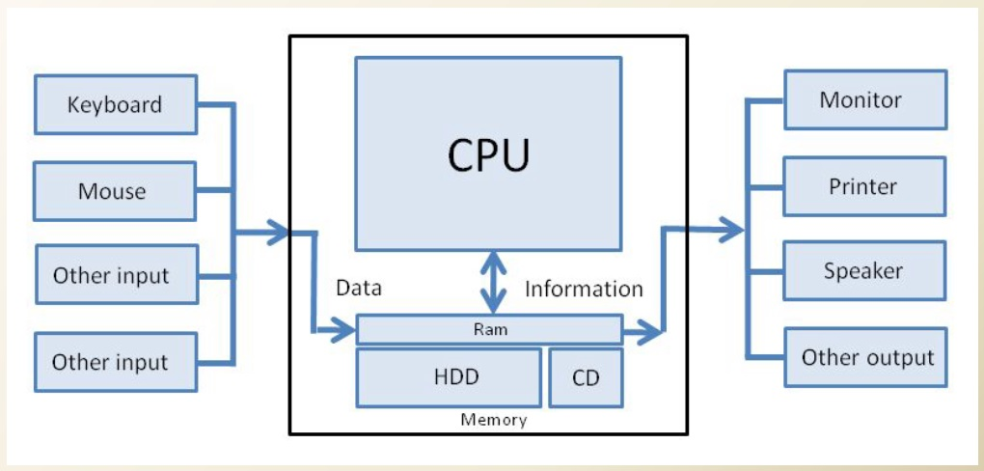
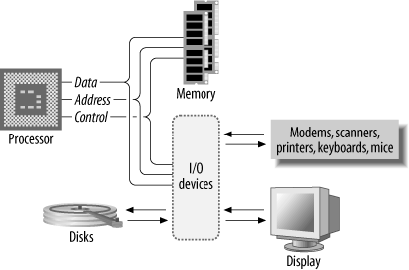
Communications!

Slide 16
What is computer in general?
A computer is a complex and modular system (in its hardware and software) for problem solving, computing, and data processing in different domains.
Input
Processing
Output

Slide 17
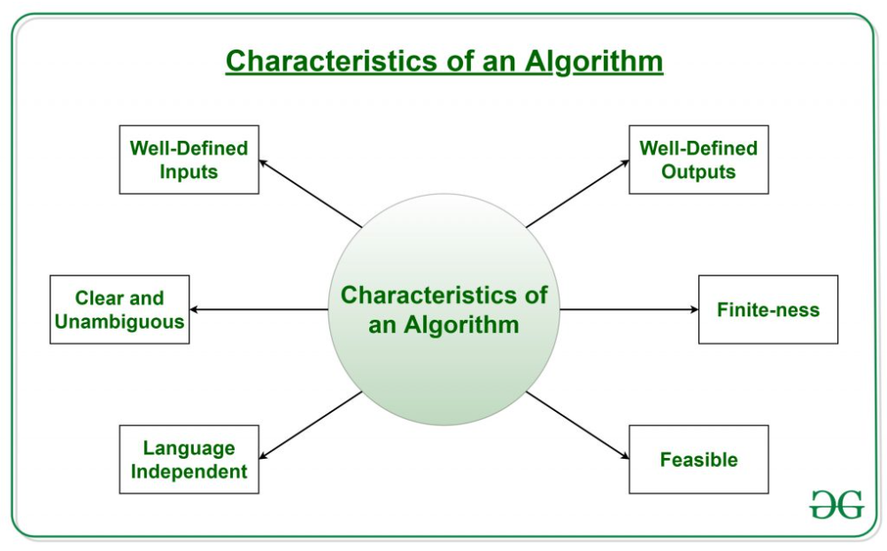
The characteristics of Algorithm!

Slide 18
Primitive Instructions

Slide 19
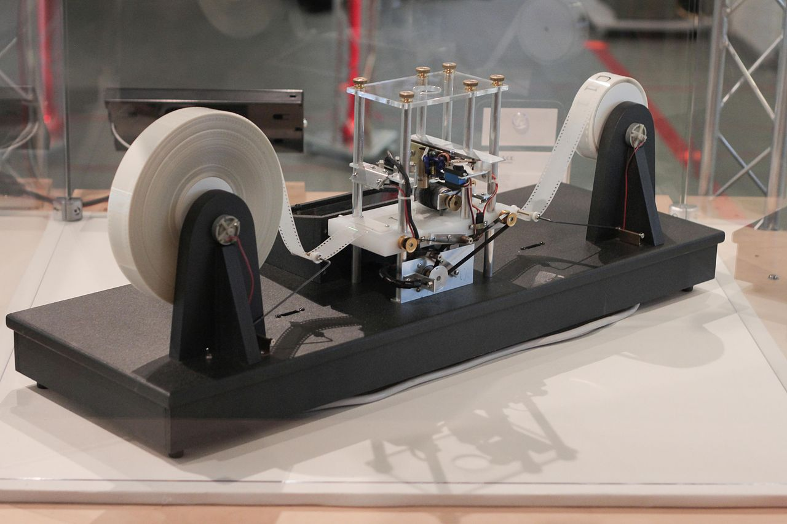
Turing Machine

Slide 20
Building block of languages
Today programming languages have more convenient set of primitives.
We can create new primitives…
Anything computable in one language is computable/ transformable in/to another languages.

Slide 21
We have six core (primitive) instructions. What are these and WHY are these?
Who is volunteer for the short presentation?

Slide 22
Going into bigger and more complex
Set of primitive instructions are provided by programming languages.
Legal (valid) combination of primitives makes expressions.
You can interpret an expression and compute its value.

Slide 23
Language Structure

Slide 24
Level of processing in a language!
Word-level (primitives)
Syntax
Semantic
Discourse (valid result)

Slide 25
Level of errors in a language!
Word-level (primitives) error
Syntax error
Semantic error
Discourse (valid result) error

Slide 26
Every things have a language!?
Genes
Humans
Computer
Mechanical device
Trees
Animals
Algorithms
Programming (formal)
…

Slide 27
Python Programming Language

Slide 28
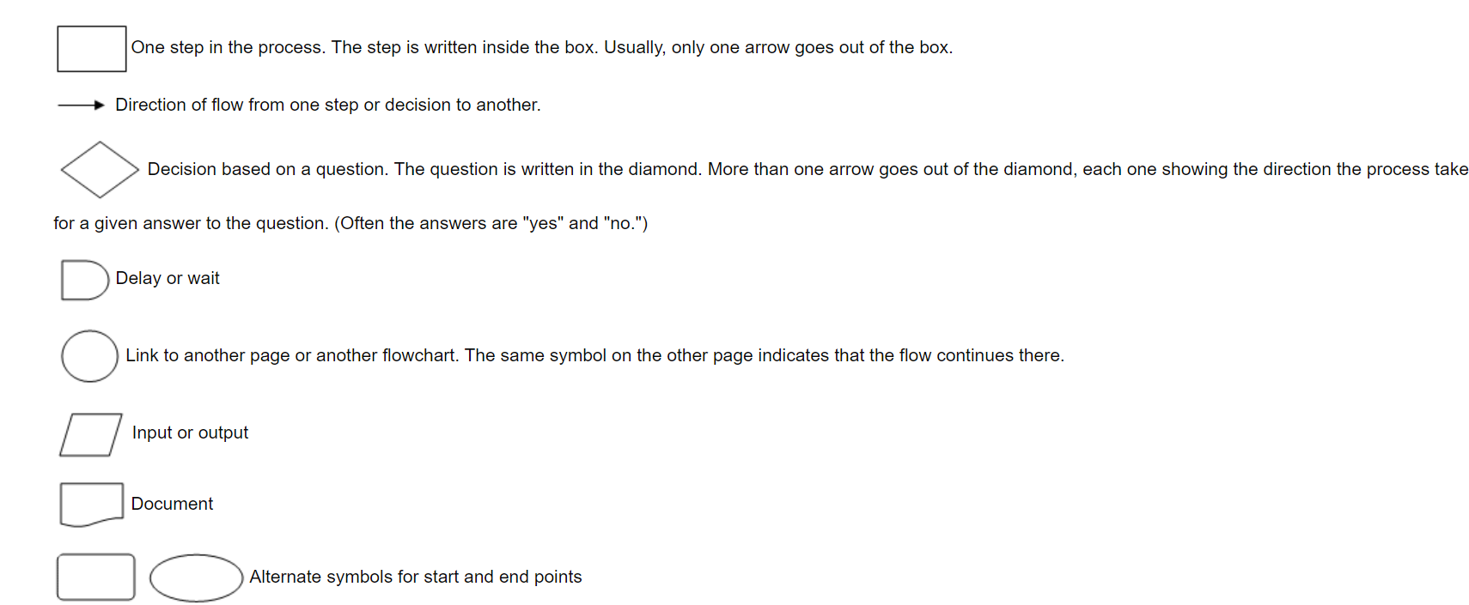
Flowchart

Slide 29

Simple Calculator
Input: two numbers
Output: calculate the result of -, +, *,/

Slide 30
Find dictionary of a text
Input: text
Output: some statistics (count)

Slide 31
Application of Programming in the Digital Age!

Slide 32
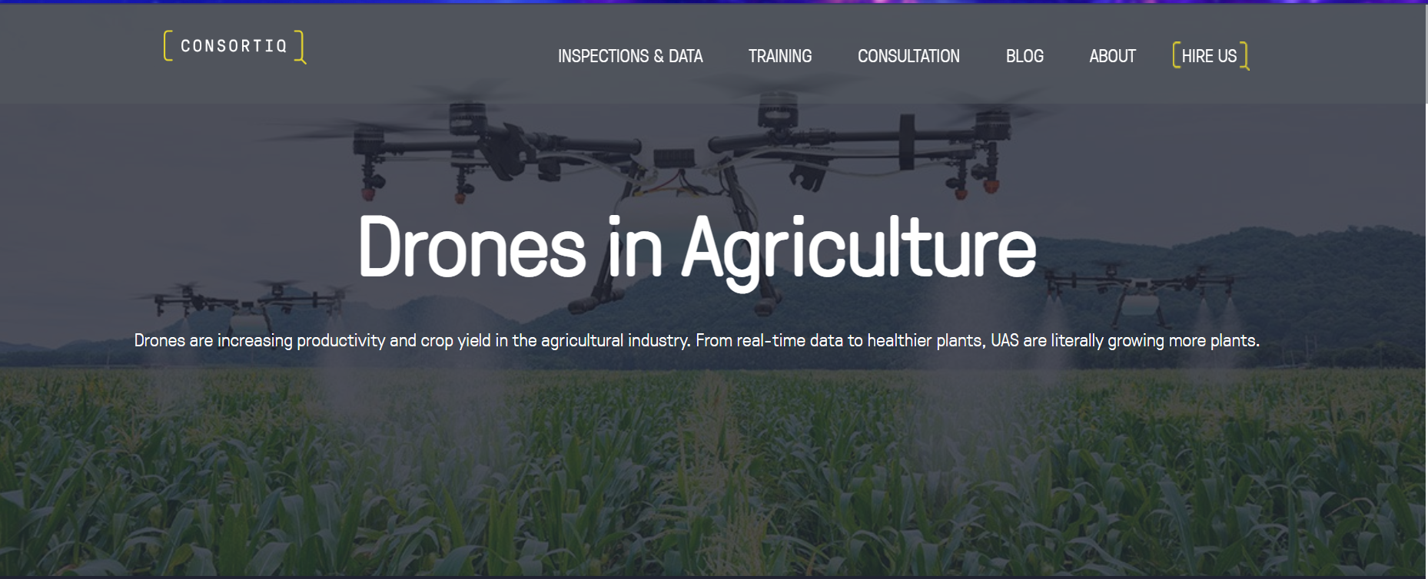
AgTech…

Slide 33
Lecture Resources
https://asq.org/quality-resources/flowchart#:~:text=A%20flowchart%20is%20a%20picture,process%2C%20or%20a%20project%20plan.

